Slide 1
AVL Trees Balancing Trees using AVL - Using Rotations
Department of Computer Science and Software Engineering
Capital University of Sciences & Technology, Islamabad Pakistan

Slide 2
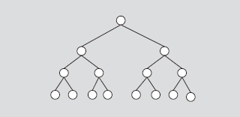
Perfectly Balanced tree
The heights of the left and right subtrees of the root are equal.
The left and right subtrees of the root are perfectly balanced binary trees.

Slide 3
Balanced Tree(AVL tree – by G. M. Adelson-Velskii and E. M. Landis )
Named after their inventor Adelson, Velski & Landis, AVL trees are height balancing binary search tree. AVL tree checks the height of the left and the right sub-trees and assures that the difference is not more than 1. This difference is called the Balance Factor.

Slide 4
AVL Tree
AVL trees are height-balanced binary search trees
Balance factor of a node
Height(left subtree) – Height(right subtree)
An AVL tree has balance factor calculated at every node
For every node, heights of left and right subtree can differ by no more than 1
The left and right subtrees of the root are AVL trees.

Slide 5


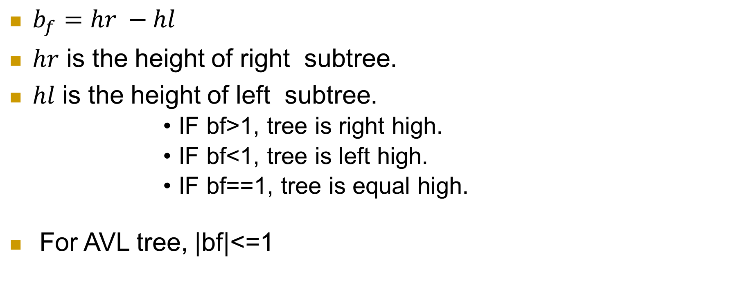
Balance Factor
$b_{f}=hr −hl$
$hr$ is the height of right subtree.
$hl$ is the height of left subtree.
IF bf>1, tree is right high.
IF bf<1, tree is left high.
IF bf==1, tree is equal high.
For AVL tree, |bf|<=1

Slide 6
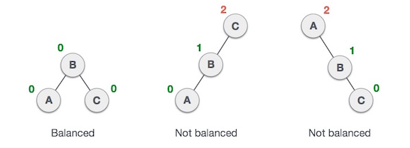
Here we see that the first tree is balanced and the next two trees are not balanced −
In the second tree, the left subtree of C has height 2 and the right subtree has height 0, so the difference is 2. In the third tree, the right subtree of A has height 2 and the left is missing, so it is 0, and the difference is 2 again. AVL tree permits difference (balance factor) to be only 1.

Slide 7
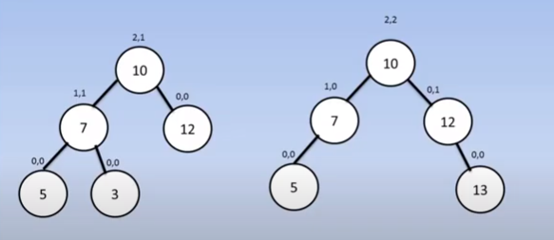
These trees are AVL trees?

Slide 8
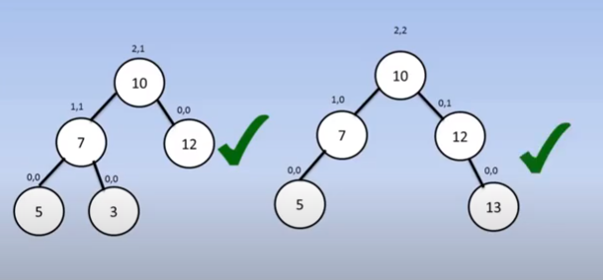
These trees are AVL trees?

Slide 9
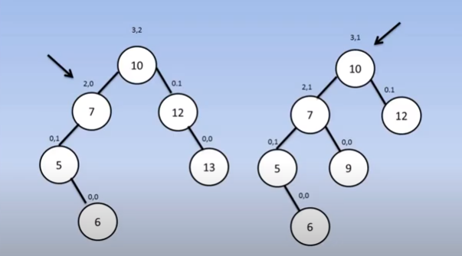
These trees are AVL trees?

Slide 10
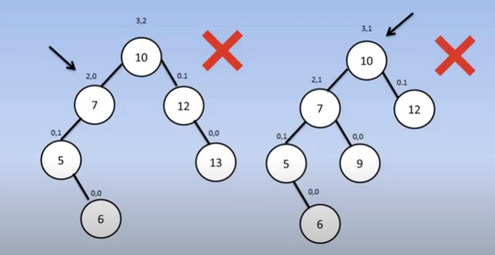
These trees are AVL trees?

Slide 11
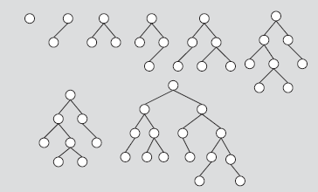
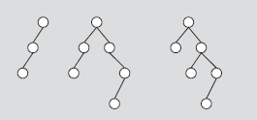
Which trees are AVL?

Slide 12
Balancing Trees using AVL - Using Rotations
If the difference in the height of left and right sub-trees is more than 1, the tree is balanced using some rotation techniques.
To balance itself, an AVL tree may perform the following four kinds of rotations
Left Rotation
Left Right Rotation
Right Rotation
Right Left Rotation

Slide 13
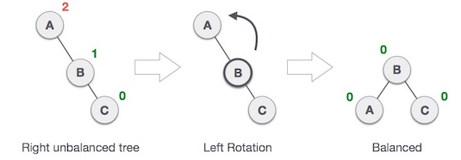
Left Rotation
If a tree becomes unbalanced, when a node is inserted into the right subtree of the right subtree, then we perform a single left rotation −
In our example, node A has become unbalanced as a node is inserted in the right subtree of A's right subtree. We perform the left rotation by making A the left-subtree of B.

Slide 14
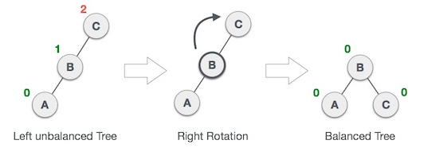
Right Rotation
AVL tree may become unbalanced, if a node is inserted in the left subtree of the left subtree. The tree then needs a right rotation.
As depicted, the unbalanced node becomes the right child of its left child by performing a right rotation.

Slide 15
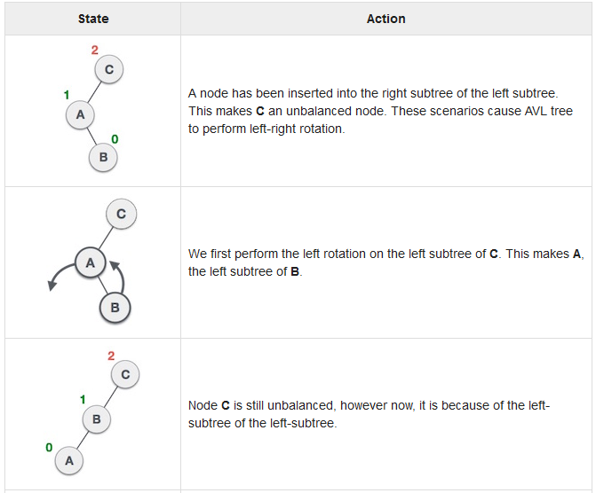
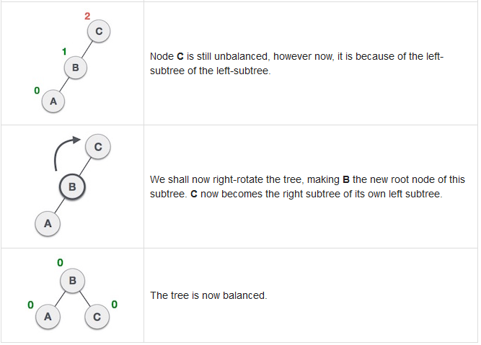
Left-Right Rotation
Double rotations are slightly complex version of already explained versions of rotations. To understand them better, we should take note of each action performed while rotation. Let's first check how to perform Left-Right rotation.
A left-right rotation is a combination of left rotation followed by right rotation.

Slide 16
Left-Right Rotation
A node has been inserted into the right subtree of the left subtree. This makes C an unbalanced node. These scenarios cause AVL tree to perform left-right rotation.
We first perform the left rotation on the left subtree of C. This makes A, the left subtree of B.
Node C is still unbalanced, however now, it is because of the left-subtree of the left-subtree.
We shall now right-rotate the tree, making B the new root node of this subtree. C now becomes the right subtree of its own left subtree.
The tree is now balanced.

Slide 17
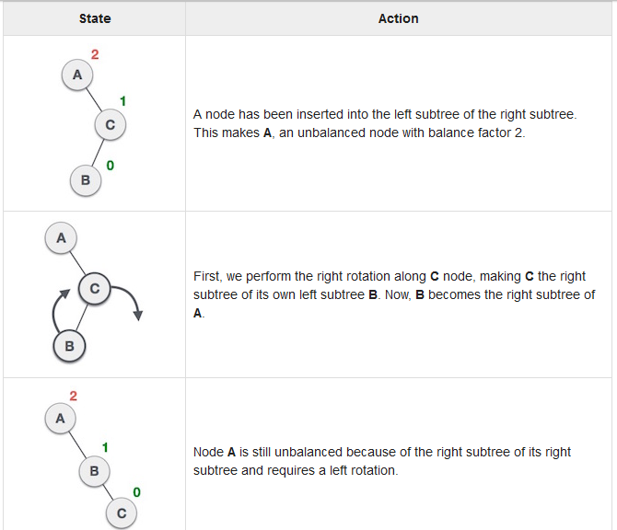
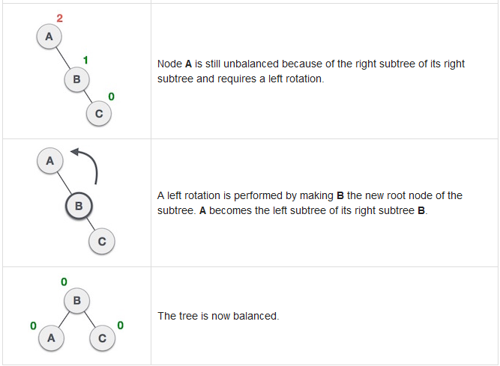
Right-Left Rotation
The second type of double rotation is Right-Left Rotation. It is a combination of right rotation followed by left rotation

Slide 18
Right-Left Rotation
A node has been inserted into the left subtree of the right subtree. This makes A, an unbalanced node with balance factor 2.
First, we perform the right rotation along C node, making C the right subtree of its own left subtree B. Now, B becomes the right subtree of A.
Node A is still unbalanced because of the right subtree of its right subtree and requires a left rotation.
A left rotation is performed by making B the new root node of the subtree. A becomes the left subtree of its right subtree B.
The tree is now balanced.

Slide 19
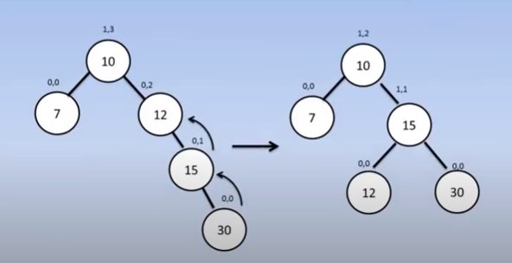
Left Left Rotation

Slide 20
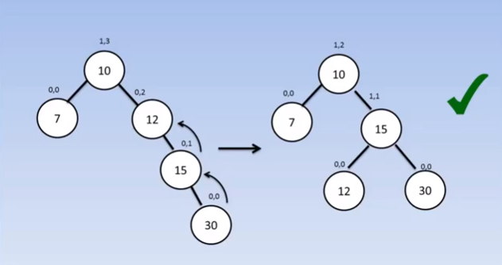
Left Left Rotation

Slide 21
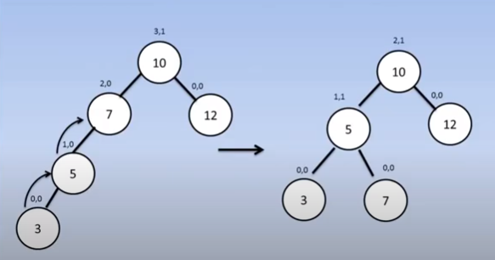
Right Right Rotation

Slide 22
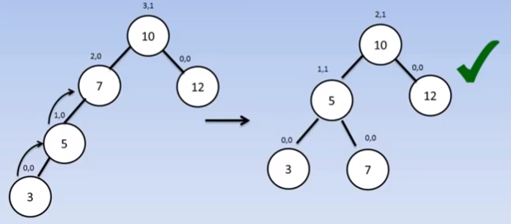
Right Right Rotation

Slide 23
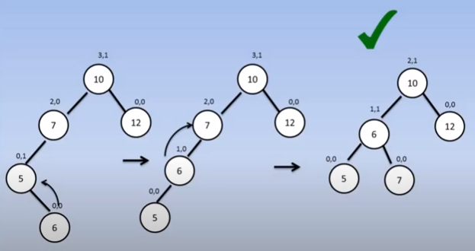
Left Right Rotation

Slide 24
Left Right Rotation

Slide 25
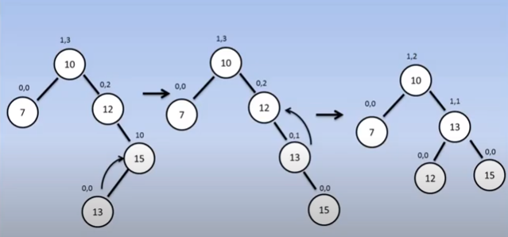
Right Left Rotation

Slide 26
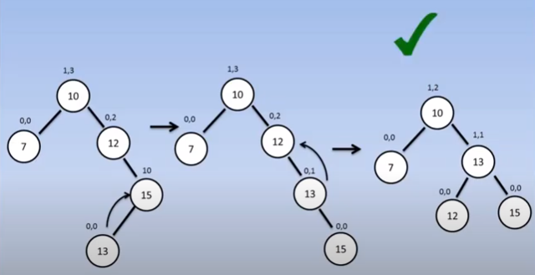
Right Left Rotation

Slide 27
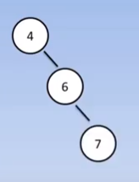
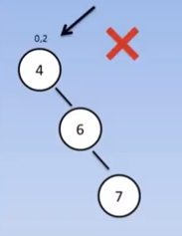
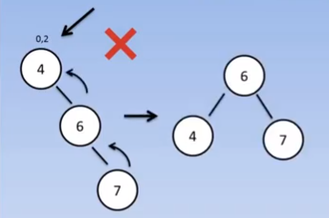
AVL Balancing
AVL tree is a self-balancing Binary Search Tree (BST) where the difference between heights of left and right subtrees cannot be more than one for all nodes.
AVL Tree Operations (Insert, Delete)
Insert 4, 6, 7, 9, 2, 10

Slide 28
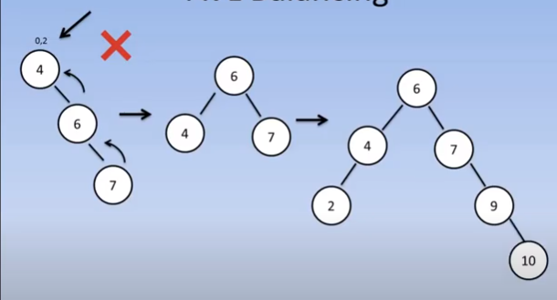
AVL Balancing
Insert 4, 6, 7, 9, 2, 10

Slide 29
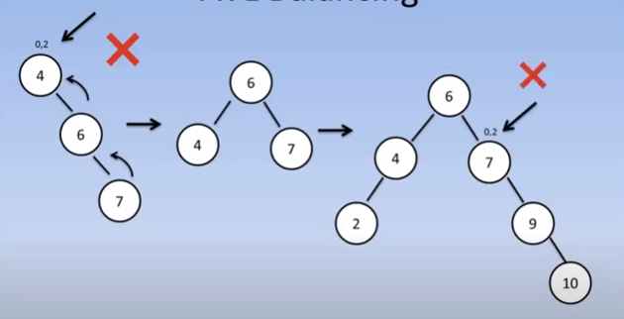
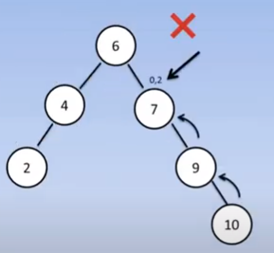
AVL Balancing
Insert 4, 6, 7, 9, 2, 10

Slide 30
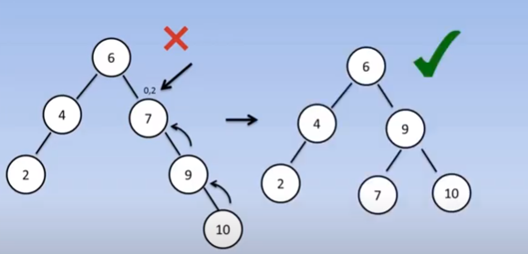
Balanced AVL Tree
Insert 4, 6, 7, 9, 2, 10

Slide 31
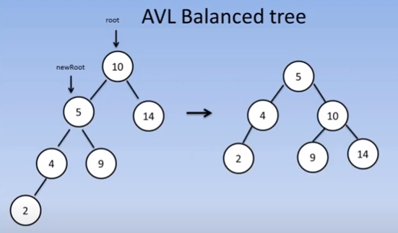
AVL – Right Rotation:
By using Right AVL Rotation balanced this tree on equal heights.

Slide 32
AVL Balanced tree

Slide 33
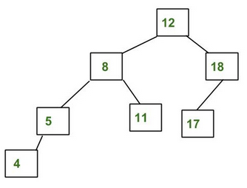
AVL Tree : Insertion
AVL tree is a self-balancing Binary Search Tree (BST) where the difference between heights of left and right subtrees cannot be more than one for all nodes.

Slide 34
AVL Tree : Insertion
To make sure that the given tree remains AVL after every insertion, we must augment the standard BST insert operation to perform some re-balancing. Following are two basic operations that can be performed to re-balance a BST without violating the BST property
(keys(left) < key(root) < keys(right)).

Slide 35
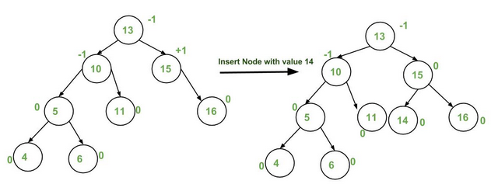
Insertion Examples:

Slide 36
Insertion Examples:

Slide 37
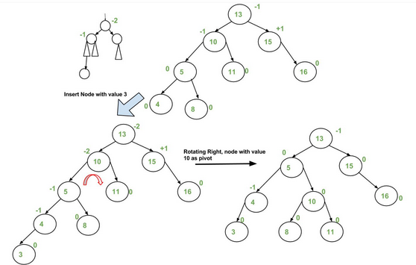
Insertion Examples:

Slide 38
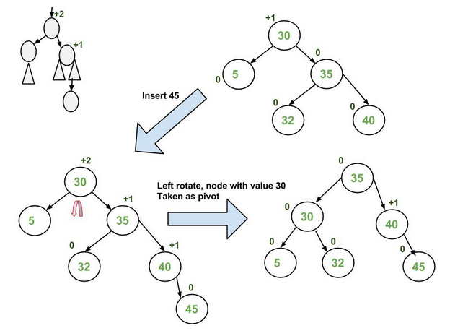
Insertion Examples:

Slide 39
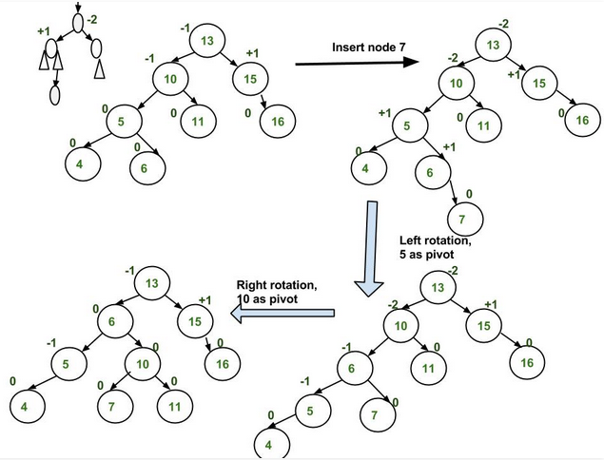
Insertion
Examples:

Slide 40
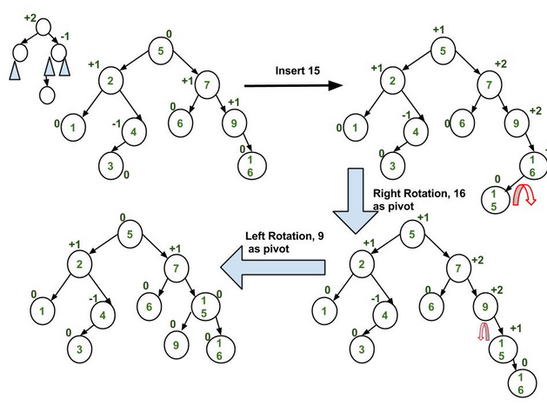
Insertion
Examples:

Slide 41
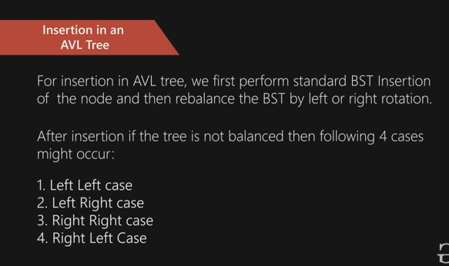

Slide 42
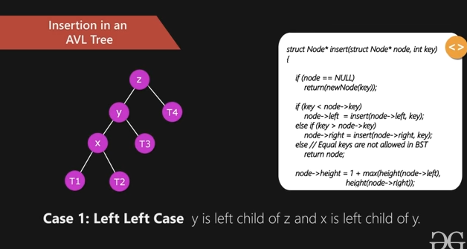

Slide 43
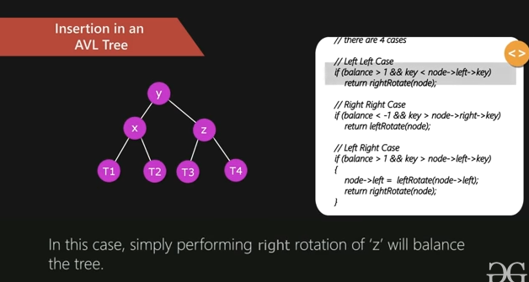

Slide 44
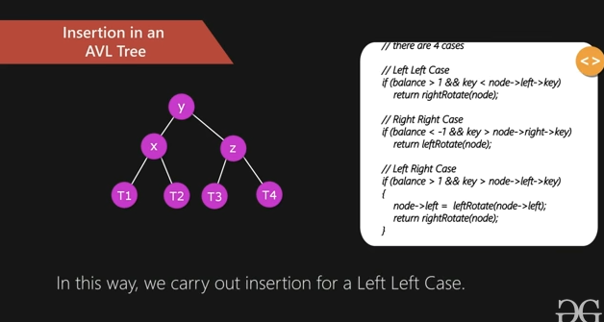

Slide 45
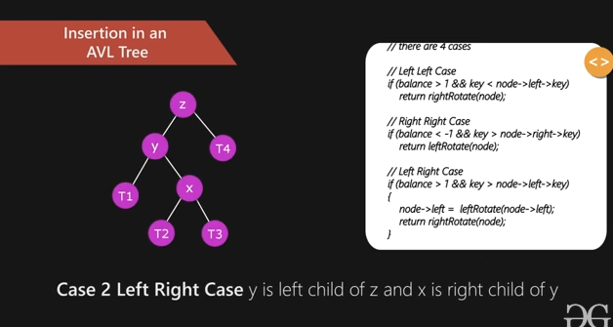

Slide 46
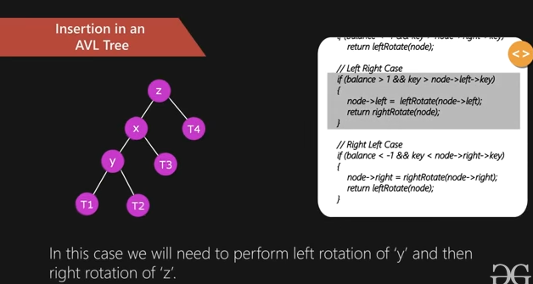

Slide 47
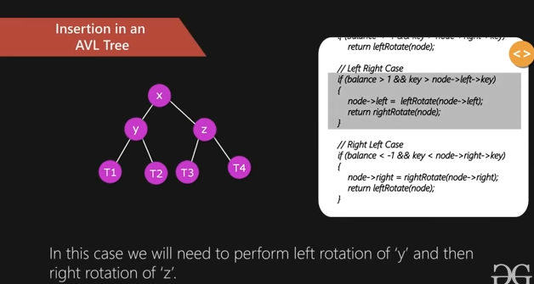

Slide 48
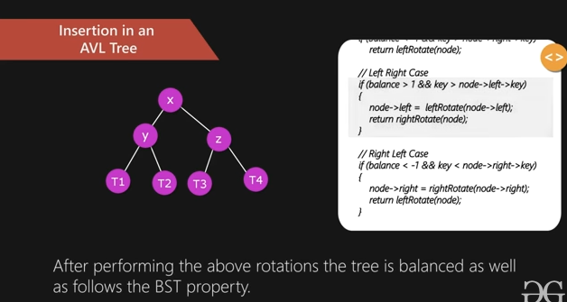

Slide 49
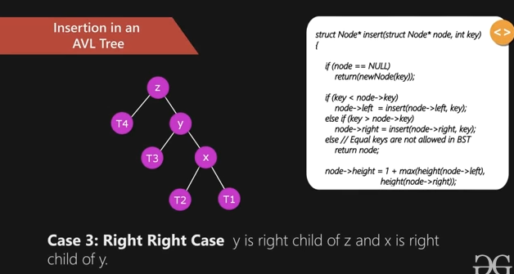

Slide 50
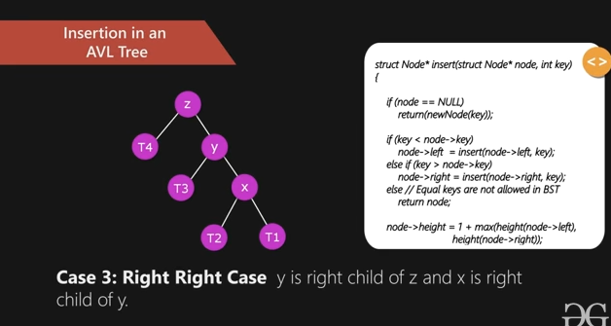

Slide 51
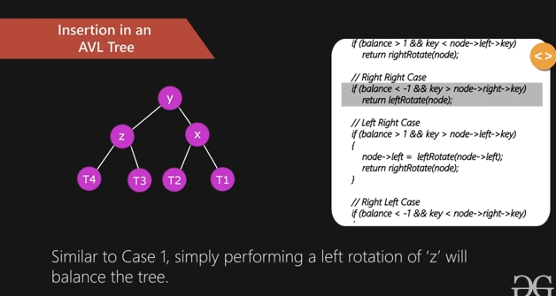

Slide 52
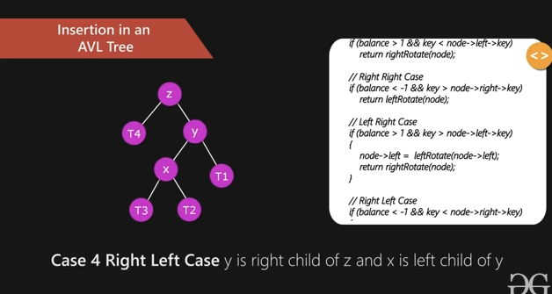

Slide 53
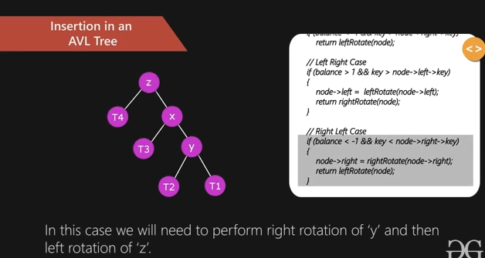

Slide 54
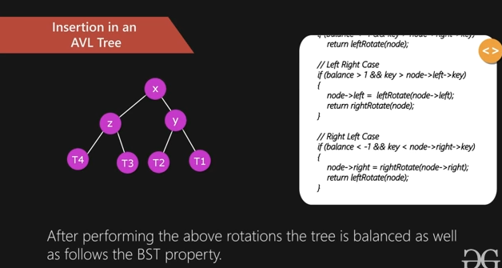

Slide 55


Slide 56


Slide 57


Slide 58


Slide 59


Slide 60


Slide 61





Slide 62





